Slide 1

Week 6 Workshop:
Spatial Transcriptomics

Slide 2
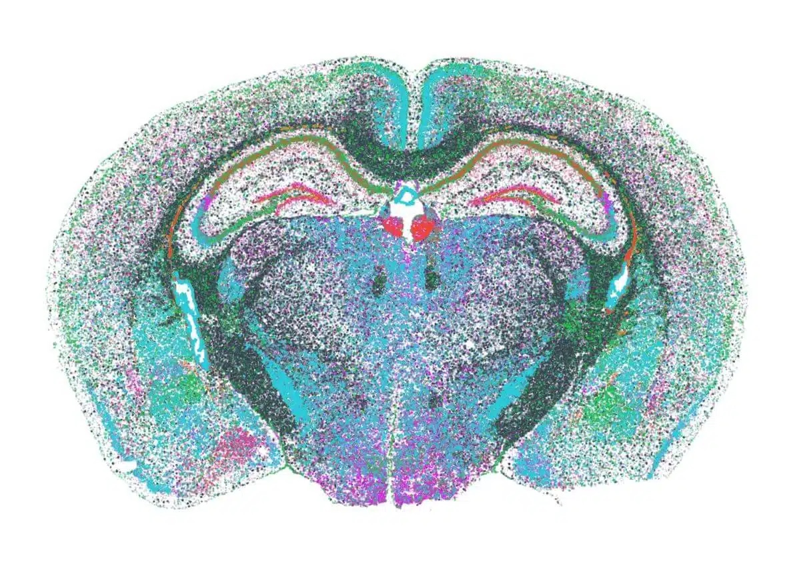
What is Spatial Transcriptomics (ST)?
Technologies which measure RNA expression levels in a tissue section and maps where they are being expressed spatially
Notes:
Can provide data for many genes in a tissue sections
Unlike traditional RNA sequencing, it preserves spatial context, showing not just which genes are active but where they are expressed

Slide 3
Spatial Transcriptomics | Single-Cell RNA seq
Intact tissue sections | Isolated cells in tissue samples
Gene expression across thousands of cells | Transcriptomic information at the single-cell level
Retains spatial information | Higher resolution
Identify and map cell subtypes in tissues

Slide 4

Bulk RNAseq vs scRNAseq vs MERFISH
scRNA versus Traditional RNA sequencing
scRNA - individual cells are isolated, allowing for individual gene expression profiles that can leads to later cell clustering
MERFISH versus scRNA
Key Advantage - MERFISH preserves spatial data
Different slices of a morphological sample can be examined
Data Collection Process
Notes:
Fluorescent Labeled Probes - Bind to RNA targets within the cell, doesn’t disturb cell architecture
Barcoded probes are used to recognize specific RNA sequences
Analyzing barcode sequences → final map of the initial location of each RNA molecule
What does this show us? Demonstrates cellular interactions and tissue/cell organization

Slide 5
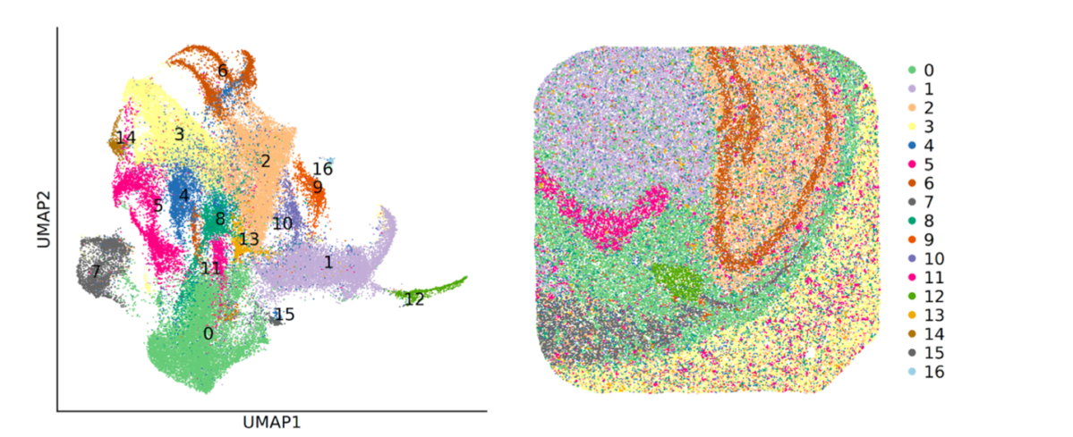
What are some applications of ST?
Notes:
Cell-to-Cell Interaction Analysis
If we see genes expressed in two different cells next to each other regularly then those genes might be involved in cell signaling.
Co-localization
Proteins and gene expressions appearing together suggest functional relationships
Mis-localization
Transcripts appearing in the wrong location may signal disease
Tissue Mapping
Identifying gene expression in specific tissue areas helps target cell types for therapies

Slide 6
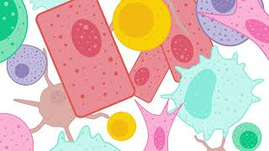
MERFISH, Spatial Transcriptomics Overviews

Slide 7
Coding Portion
Merfish Introduction Notebook

Slide 8
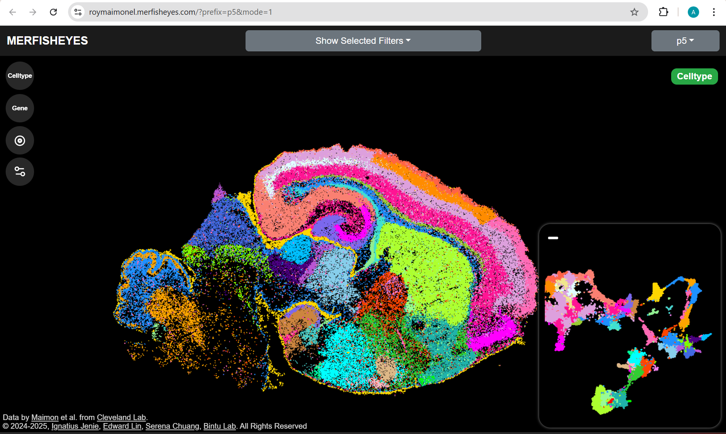
Visualizing the Cell Types
Go to website:
https://roymaimonel.merfisheyes.com/

Slide 9
Visualizing the Cell Types
Try filtering for genes to visualize where they localized:
Involved in neural development:
sox2
pax6
Neurog1
Observe how the regions of expression change depending on the stage we are looking at

Slide 10
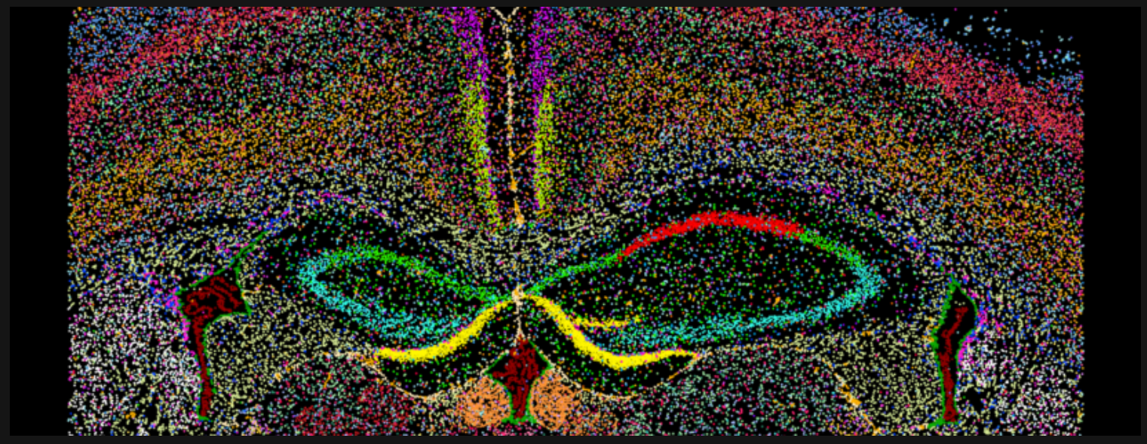
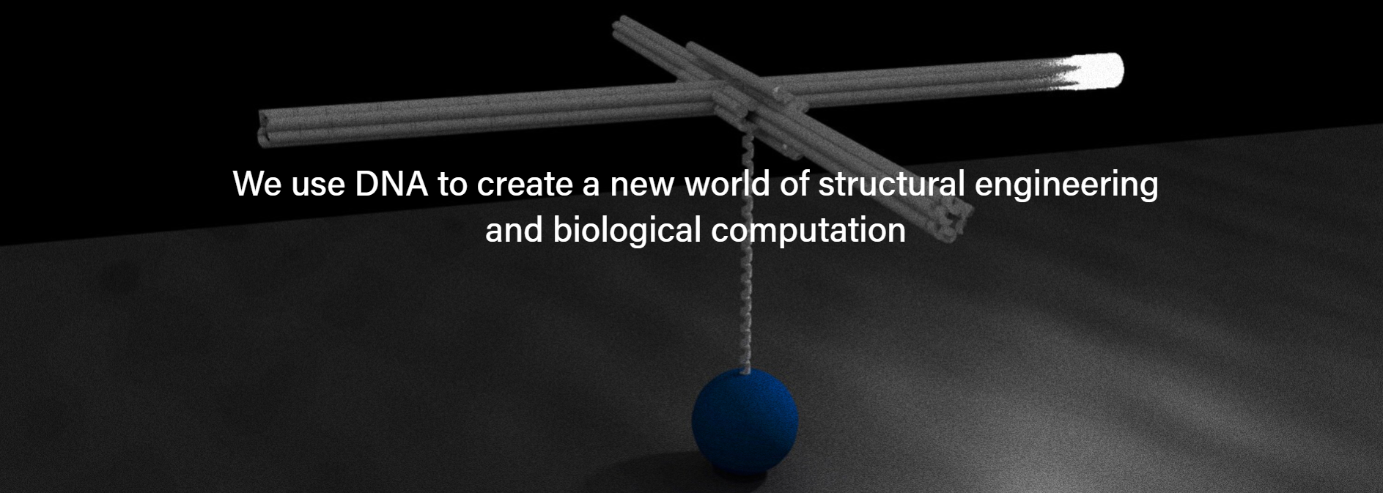
Labs on Campus
Bintu Lab
Pallav Kosuri Lab (Salk Institute)
Center for epigenomics (Quan Zhu lab)
Notes:
Bogdan Bintu Lab
This lab at UCSD uses advanced imaging and synthetic biology to explore how chromatin structure influences gene expression at the single-cell level.
Pallav Kosuri Lab (Salk Institute)
The Kosuri lab at Salk focuses on developing nanoscale devices to track molecular motion in transcription, helping to uncover spatial organization principles in gene regulation. Specifically, they have developed BellaVista, an open-source python package.
Center for Epigenomics (Quan Zhu Lab)
Dr. Quan Zhu’s group at UCSD specializes in profiling gene expression and chromatin states in intact tissues, leveraging spatial transcriptomics to study epigenomic regulation.
All these labs focus on the development of tools used in spatial transcriptomics.

